Slide 1
Digital Portfolio
STUDENT NAME: Poorna Kala S
REGISTER NO: 2426J0433
NMID: EDE4D05CC604A70A60441F54DB891A39
DEPARTMENT: Information technology
COLLEGE: Sri Krishna Adithya College of Arts and Science / Bharathiyar University

Slide 2
PROJECT TITLE
“TasteAI: Intelligent Flavor Pairing & Recipe Recommendation”

Slide 3

AGENDA
Problem Statement
Project Overview
End Users
Tools and Technologies
Portfolio design and Layout
Features and Functionality
Results and Screenshots
Conclusion
Github Link

Slide 4

PROBLEM STATEMENT
Cooking at home can often feel repetitive because people lack inspiration or don’t know which ingredients pair well together. Traditional recipe apps provide static lists of recipes, but they fail to suggest new, creative, or health-conscious flavor pairings. There is a need for an intelligent system that helps users: Discover unique ingredient combinations. Get personalized recipe recommendations. Reduce food waste by suggesting recipes from available ingredients.

Slide 5
PROJECT OVERVIEW
TasteAI is an intelligent web-based application that leverages AI and flavor science to suggest ingredient pairings and recipe recommendations. The system analyzes user preferences, available ingredients, and dietary needs to generate recipes that are: Innovative – based on flavor matching. Personalized – tailored to taste and diet. Efficient – reduces food waste by suggesting recipes from what users already have.

Slide 6

WHO ARE THE END USERS?
Home Cooks → Looking for easy & creative recipes. Students/Working Professionals → Who want quick meal ideas with limited ingredients. Food Enthusiasts & Chefs → To experiment with new flavors. Health-Conscious Users → For personalized diet-friendly recipes.

Slide 7
TOOLS AND TECHNIQUES
Frontend: HTML, CSS, JavaScript Backend (optional for future): Python (Flask/Django) or Node.js Database: MySQL / MongoDB AI/ML Models: Flavor compound matching, Collaborative filtering for recommendations APIs: Edamam / Spoonacular API (for recipe data) Design Tools: Figma / Canva (for UI mockups)

Slide 8
PORTFOLIO DESIGN AND LAYOUT
The portfolio layout is clean, minimal, and food-themed: 1. Home Page → Project title, tagline, and intro. 2. Problem & Solution Section → Explains what TasteAI solves. 3. Screenshots / UI Demo → Sample of recipe recommendation interface. 4. Tech Stack Section → Icons/logos of HTML, CSS, JS, Python, DB.
8

Slide 9
5. Features Page → Interactive cards showing major features. 6. Results Section → Example recipe suggestions with images. 7. Conclusion Page → Summarizing achievements & scope for future work.

Slide 10
FEATURES AND FUNCTIONALITY
✅ Ingredient Input → Users can enter available ingredients. ✅ Flavor Pairing → Suggests best ingredient combinations. ✅ Recipe Recommendations → Displays recipes with cooking steps & images. ✅ Dietary Filters → Vegan, Vegetarian, Gluten-free, etc. ✅ Save & Share Recipes → Users can bookmark or share favorite dishes. ✅ AI Personalization → Learns from past choices for better suggestions.

Slide 11
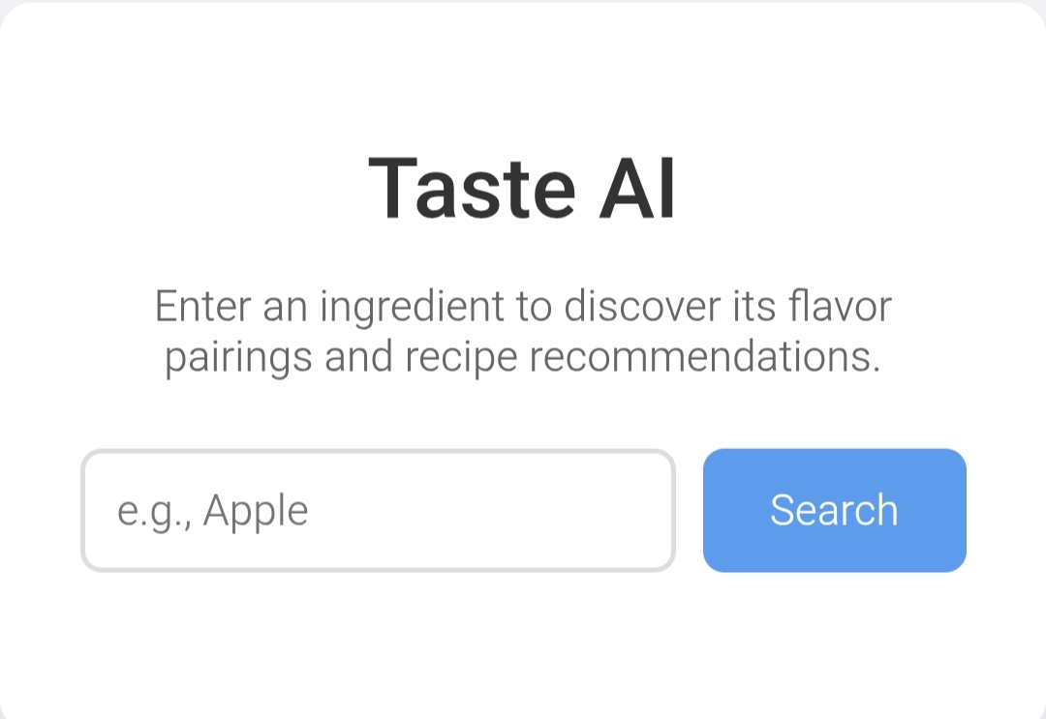
RESULTS AND SCREENSHOTS
11

Slide 12
CONCLUSION
TasteAI successfully demonstrates how artificial intelligence can make cooking more creative, efficient, and personalized. The system helps users explore new flavor combinations, reduces food waste, and offers tailored recipe recommendations. Future enhancements could include: Full integration with real-time recipe APIs. Voice assistant support for cooking. Nutritional analysis and calorie tracking.
12

Slide 13
Github Link
https://github.com/24bsit141poornakalas-source/TNSDC-FWD-DIGITAL_PORTFOLIO.git

